Slide 1
The Pitch: Creating
a Seed Stage Investor Presentation

Slide 2
THE PITCH
Investors are the primary audience
You must capture their attention in the first 60 seconds
An effective pitch is no more than 16 slides
Tell your story like a story
Help your audience get a picture in their heads
You will have a maximum 20 minutes to present to Rev1. However, other investors may prefer no more than 8-15 minutes
Rehearse. Rehearse. Rehearse.

Slide 3
THE PITCH: TABLE OF CONTENTS
Title Slide
Customer Problem / Opportunity
Your Solution / Technology
Examples of your Solution/Tech
Market Demand
Business Model / Sales
Competition / Status Quo
Competitive Matrix
Growth Opportunity
Management Team
Sources & Use of Funds
Example: Uses of Funds Chart
Company Milestones
Example: Milestones Chart
Financial Projections
Example: Financial Analysis Table
Risk Assessment
Exit Strategy
Appendix Slides
Rules for the Pitch
Key Questions to Answer
Note:
These are the recommended talking points. Please feel free to modify the flow of the slides to tell your story in the most compelling way.
Resources:
Angel Capital Foundation • Angel Resource Institute • Ohio TechAngels
The Entrepreneur’s Handbook

Slide 4
TITLE SLIDE
Introduce yourself and your role
Feature company name/graphics
Deliver your two-line elevator pitch
Share a brief company history
State why you are there
Spend less than 2 minutes on this slide

Slide 5
CUSTOMER PROBLEM/ OPPORTUNITY
Clearly communicate the “problem” in the market, laying the foundation for the pitch
How do you know there is a “problem” in the market? (Hint: customers told you in clear terms)
Who are the specific customers and what do they need…
The cost of the problem? The cost of the problem or value of the opportunity…

Slide 6
YOUR SOLUTION/ TECHNOLOGY
Discuss how your technology/ product solves customers’ problems or gives them a competitive advantage by:
Summarizing the solution, emphasizing your unique product/ technology
Describing any barriers to entry or IP protection for your technology
Providing specific personal experience from talking with potential customers
Focusing on customer benefits from your differentiated features

Slide 7
YOUR SOLUTION/ TECHNOLOGY
Provide no more than 2 examples describing your solution’s “unfair advantage”
Outline customers’ ROI, including the time to recoup their investment
Highlight actual examples that have been or will be deployed at customer sites, if applicable.

Slide 8
MARKET DEMAND
Quantify the market by size, segments and potential sales (TAM/SAM)
Avoid sky-high numbers – be realistic
Characterize the key benefits to target customers - why will they buy?
Show urgency for the product
Which segments will you target first, why?

Slide 9
BUSINESS MODEL AND SALES
Describe how your product or service generates revenue for the company
Keep the explanation simple
Include these key points:
How do you charge?
What is your pricing strategy?
What is your channel strategy for reaching initial customers?
Why is your business model scalable?

Slide 10
COMPETITION/ STATUS QUO
Create a Competitive Matrix comparing you to competitors – don’t forget the status quo is competition!
Include large and small competitors
The well established and better known
The up-and-comers
Describe your strongest barriers to prevent competition from eating your lunch.
Must customers change behavior to adopt? How do you mitigate that?

Slide 11
EXAMPLE: COMPETITIVE MATRIX

Slide 12
GROWTH OPPORTUNITIES
Describe company growth potential. Are there other verticals? Other applications? Additional product opportunities?
Avoid over-reaching with “hockey stick” projections
Use your research to illustrate how the market is growing

Slide 13
TEAM
Show your team strength as individuals and how you form an effective team
Indicate full-time/part-time – who does what and why
Use bullet points to highlight key experience
Entrepreneurial experience
Years in target markets
Experience producing technical and market results
Highlight advisors/board of directors

Slide 14
SOURCES & USES OF FUNDS
How much does the company need to raise this round to achieve milestones?
Any prospective co-investment? If so, how much and from whom? Don’t forget to include the specific amount of funds requested from Rev1
What activities will be funded from this raise? (break down into high-level line item buckets). Suggested format on next slide. Be sure to footnote what milestones are achieved.

Slide 15
EXAMPLE: USE OF FUNDS CHART
 | 2017 |  |  |  |  |  |  |  |  |  |  |  | 2018
 | January | February | March | April | May | June | July | August | September | October | November | December | January | February
Payroll | $25 | 25 | 25 | 25 | 25 | 25 | 25 | 25 | 25 | 25 | 25 | 25 | 25 | 25
Outsourced Development | 10 | 10 | 10 | 10 | 40 | 40 | 5 | 5 | 5 | 25 | 25 | 25 | 10 | 10
Legal | 15 | 10 | 5 | 0 | 0 | 0 | 0 | 0 | 0 | 0 | 5 | 10 | 15 | 15
Accounting | 1 | 1 | 1 | 1 | 1 | 3 | 3 | 3 | 3 | 3 | 3 | 3 | 3 | 3
Bucket 5 | 25 | 10 | 5 | 0 | 0 | 0 | 0 | 0 | 0 | 0 | 0 | 0 | 0 | 0
Bucket 6 | 25 | 10 | 5 | 5 | 5 | 5 | 5 | 5 | 5 | 5 | 5 | 5 | 5 | 5
Total | $101 | 66 | 102 | 41 | 71 | 73 | 38 | 38 | 38 | 58 | 63 | 68 | 58 | 58
Cash Balance | 899 | 833 | 731 | 690 | 619 | 546 | 508 | 470 | 432 | 374 | 311 | 243 | 185 | 127
***In thousands & Assuming Raise of $1M
Company Will Achieve the following milestones
5 Paid Betas by June 2017
Hire CTO by February 2018
Validate Value of Date with customers by January 2018

Slide 16
COMPANY MILESTONES
Include a historical milestone chart to illustrate key progress to date
Include a projected milestone chart to illustrate future objectives including and beyond this particular fundraise
This chart will tie to all assumptions, sources and uses of funds that are expressed in the presentation
Include these key milestones:
Company formation, key personnel
Technology or product achievements
Any paying customers
Past capital rounds
Future investments
Exit

Slide 17
EXAMPLE: MILESTONES CHART
 | 2016 |  |  | 2017 |  |  | 2018 |  |  | 2019 |  |  | 2020 | 2021
 | Jan-Mar | Mar-July | July-Dec | Jan-Mar | Mar-July | July-Dec | Jan-Mar | Mar-July | July-Dec | Jan-Mar | Mar-July | July-Dec
Company Formed
Product Prototype
250K Proof-of-Concept Round
$100K MRR Achieved
$1M Seed/Series A Round
Positive Cash Flow
$6M VC Round
$10M ARR Achieved
Strategic Acquisition

Slide 18
FINANCIAL PROJECTIONS
Describe the current burn rate, and how long the funds will last (runway)
Focus on the bottom line. How much capital is needed to reach positive cash flow (breakeven) and profitability?
Match critical milestones to capital needs
Base projections on assumptions generated from market analyses
Explain any spikes
Specify milestones around meaningful customer growth (not reliance on one or two)
You must be able to explain:
Short-term market adoption and penetration
Margins different than the norm
Extended periods of negative cash flow

Slide 19
EXAMPLE: FINANCIAL ANALYSIS
 | Latest Actual Financials | 2016 | 2017 |  | 2018 | 2019 | 2020
Revenue ($) | 128 | 1,200 |  | 5,400 | 13,600 | 24,300 | 36,000
Costs of Goods Sold ($) | 82 | 650 |  | 2,200 | 5,200 | 9,100 | 13,300
Gross Profit ($) | 46 | 550 |  | 3,200 | 8,400 | 15,200 | 22,700
Gross Profit (%) | 35.9% | 45.8% |  | 59.3% | 61.8% | 62.6% | 63.1%
Operational/G&A ($) | 151 | 540 |  | 1,780 | 3,600 | 6,300 | 8,100
Income/Loss before Tax ($) | (105) | 10 |  | 1420 | 4,800 | 8,900 | 14,600
Inc./Loss before Tax % | -82.0 | 0.8% |  | 26.3% | 35.3% | 36.6% | 40.6%

Slide 20
RISK ASSESSMENT
What are the key risks the company faces in completing the milestones anticipated with this financing?
Segment risk by business model, technology/product, market, execution and financing.
Strike a balance between optimism and realism

Slide 21
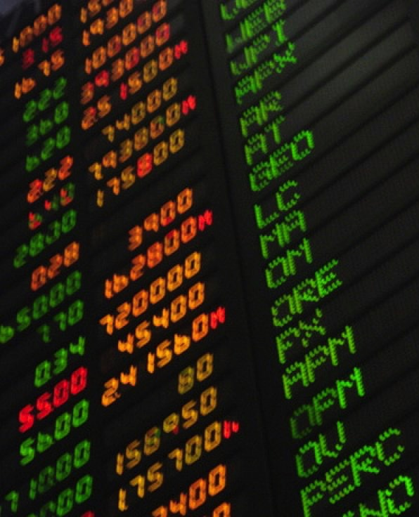
EXIT STRATEGY
Describe specific, realistic exit options
Acquisition
Identify at least two buyers and why they would be interested
Describe recent comparable transactions
Express any current relationships with potential acquirers
IPO
Describe recent comparable offerings
Be prepared to explain why your company could be an IPO candidate

Slide 22
APPENDIX
What are the details on the company’s funding history? From what sources?
Include a current Capitalization Table
Other information not included above that you want to reference if necessary

Slide 23
RULES FOR THE PITCH

Slide 24
Rehearse. Rehearse. Rehearse
Show up early and only bring key personnel
Business attire only
Use appropriate social skills, no off-color jokes
Know your stuff
Know your audience
Be courteous and respectful
Don’t read to the audience
Use simple pictures, graphics, and avoid extremely abbreviated text
Be prepared to answer questions
Be open to recommendations

Slide 25
BE PREPARED TO ANSWER THESE QUESTIONS

Slide 26
What problem does your company solve?
Who is the target user for your product or service?
Why would someone purchase your product or service?
How do you plan to acquire and keep customers?
Who are your competitors and why are they successful?
What gives your company a competitive advantage?

Slide 27
What makes your business different or unique?
Does your company have proprietary intellectual property?
What are the planned “Use of Funds”?
When will the company reach breakeven?
What are the primary risks facing your business opportunity?
What is it about your management team that makes it uniquely capable of executing on this business plan?
What’s the likely exit for founders and investors?

Slide 28
WORDS YOU NEVER WANT TO SAY

Slide 29
This is the best deal you will ever see
No one else does what we do
We are chasing multi-billion dollar markets
Our technology is the best
We don’t have any competition
Big corporations are too slow to be a threat
You have to act fast – we have first-mover advantage
Our financial projections are conservative

Slide 30
THANK
YOU

